Slide 1
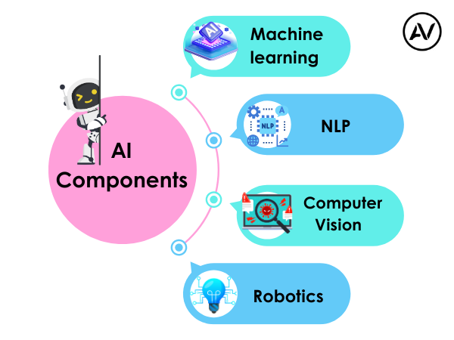
Convolutional Neural Network (CNN)
https://ellow.io/components-of-ai/

Slide 2
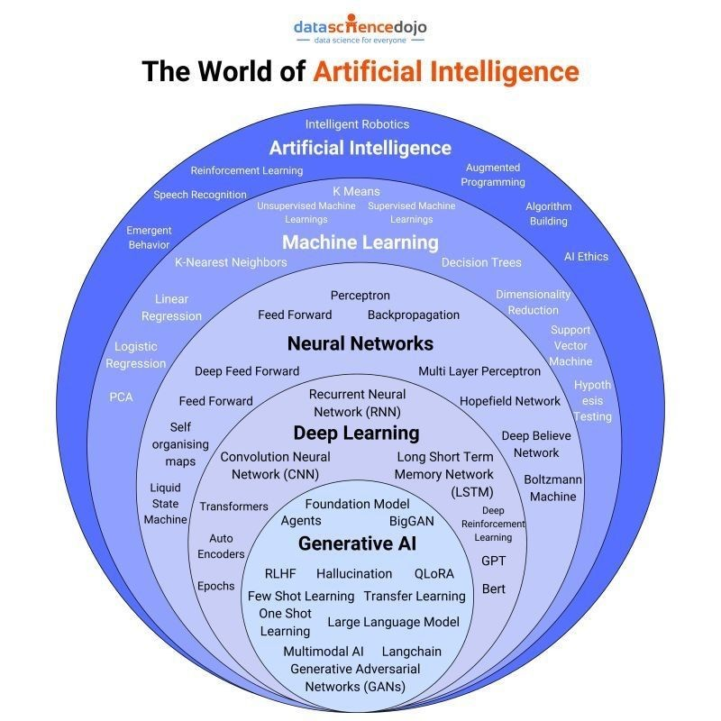
Algorithms and models

Slide 3
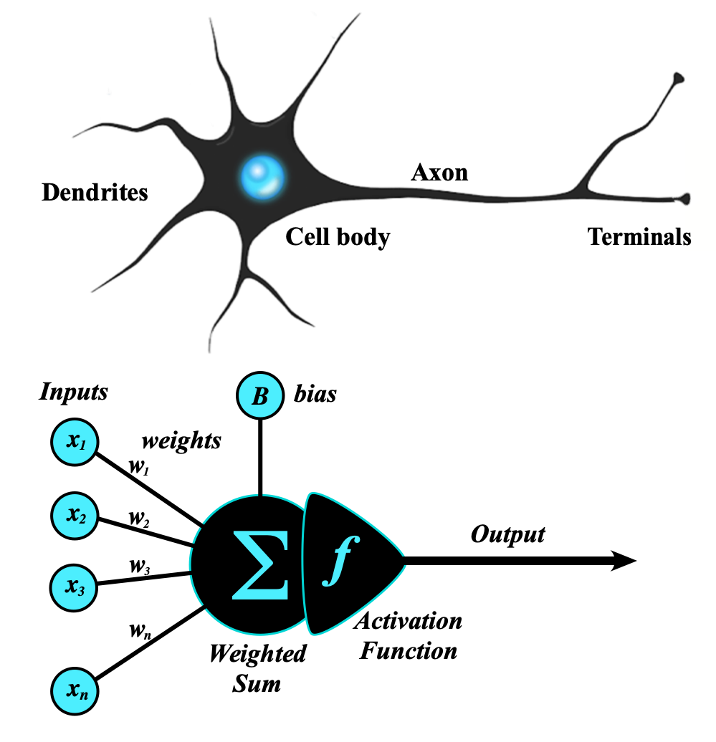
Artificial Neural Network
An artificial neural network (ANN) is a computational network (a system of nodes and the interconnection between nodes) inspired by biological neural networks, which are the complex networks of neurons in human brains (see Figure).
The nodes created in the ANN are supposedly programmed to behave like actual neurons, and hence they are artificial neurons.
The Perceptron was invented in 1957 by Frank Rosenblatt at the Cornell Aeronautics Laboratory. Based on the first concepts of artificial neurons, he proposed the “Perceptron learning rule“.
Perceptron Model
The perceptron is the simplest form of an artificial neural network and serves as the building block of more advanced models.
Components of a Perceptron:
Inputs: Feature values from the dataset.
Weights: Assigned to each input to signify importance.
Summation Function: Computes the weighted sum of inputs.
Activation Function: Applies a threshold to determine output.
https://www.geeksforgeeks.org/neural-networks-a-beginners-guide/
https://s.mriquestions.com/what-is-a-neural-network.html

Slide 4
Why do traditional Neural Networks struggle with images?
Before CNNs, researchers attempted to use traditional fully connected neural networks for image-related tasks. However, this approach posed significant challenges:
High Dimensionality:
Images are represented as matrices of pixel values. For example, a 256x256 image with three color channels (RGB) has 196,608 features! Feeding such a large number of features into a fully connected neural network makes it computationally expensive.
Loss of Spatial Information:
Fully connected layers treat all input features equally, ignoring the spatial relationships between pixels (e.g., adjacent pixels in an image often share meaningful patterns).
Overfitting:
With such high-dimensional data and limited training samples, traditional networks overfit easily.
CNNs address these problems by leveraging the spatial structure of images.

Slide 5
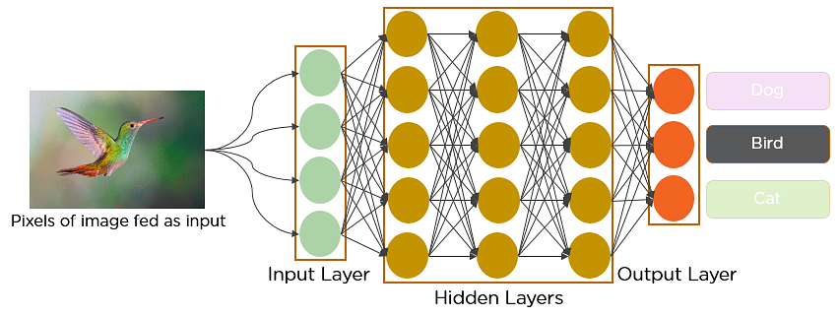
Convolutional Neural Network (CNN)
https://medium.com/@bhatadithya54764118/day-50-intro-to-cnns-image-processing-basics-46560124ceec

Slide 6
What is cnn
CNN Vs Visual Cortex | The Famous Cat Experiment | History of CNN
Convolutional Operations
Paddings &Strides
Polling (MAx polling. Average polling)
CNN ARCHtiecture (LeNet5, imagenet)
Comparing CNN VS ANN
CNN BackPropagation
Cat Vs Dog Image Classification Project | Deep Learning Project | CNN Project
Data Augmentation in Deep Learning | CNN
Pretrained models in CNN | ImageNET Dataset | ILSVRC | Keras Code
What does a CNN see? | Visualizing CNN Filters and Feature Maps | CampusX
https://www.deeplearningwizard.com/deep_learning/practical_pytorch/pytorch_convolutional_neuralnetwork/#padding

Slide 7
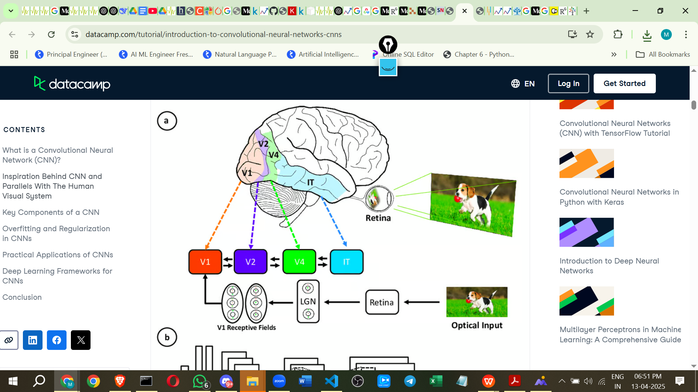
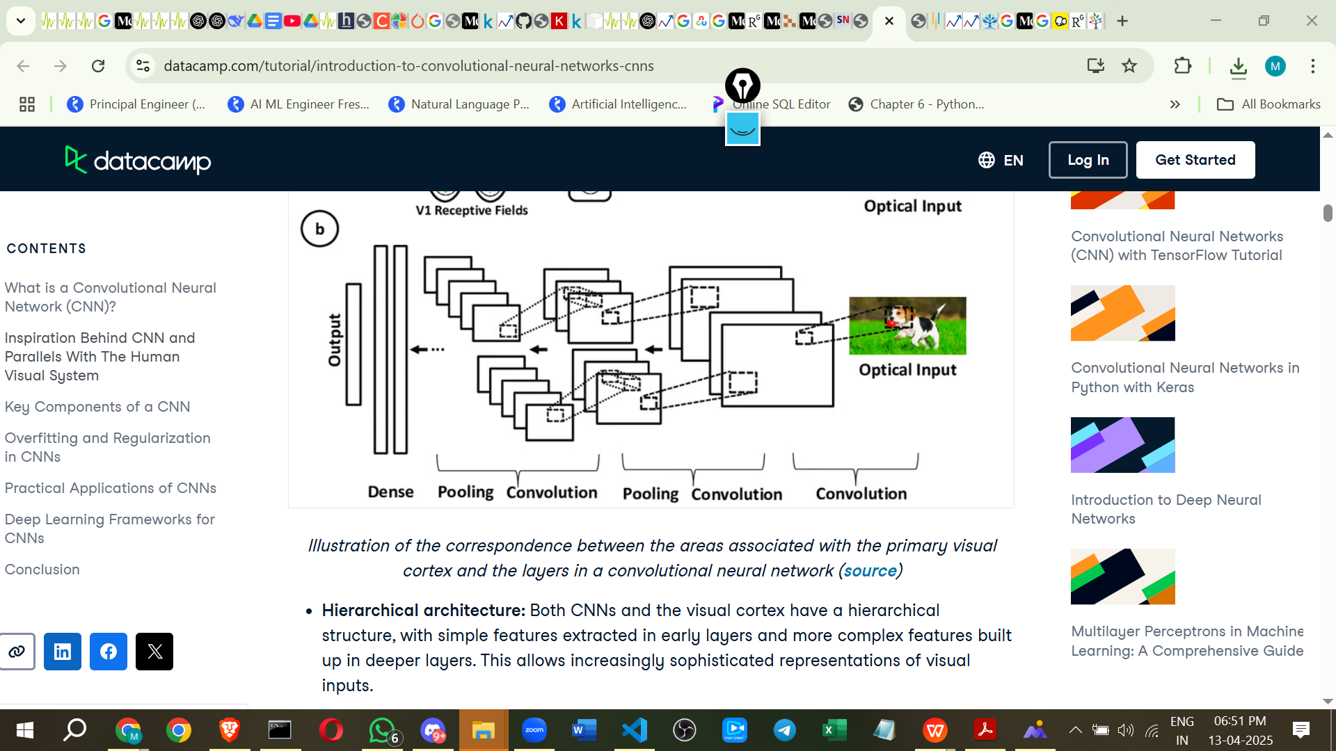
Inspiration Behind CNN and Parallels With The Human Visual System
https://www.datacamp.com/tutorial/introduction-to-convolutional-neural-networks-cnns

Slide 8
HISTORY
Since the 1950s, AI researchers have worked on systems to understand visual data, leading to Computer Vision. In 2012, a breakthrough came with AlexNet, developed by Alex Krizhevsky at the University of Toronto.
It achieved 85% accuracy in the ImageNet contest, far surpassing previous models. This success was driven by Convolutional Neural Networks (CNNs), which mimic human vision.
CNNs are now vital for tasks like image classification, object detection, and segmentation. Modern CNNs use Python and advanced techniques to learn image features, relying on hyperparameters and optimization for training.
Advances like VGG, ResNet, and EfficientNet have expanded CNN applications in fields like autonomous driving and medical imaging. In this article, you will get to know all about CNN, advantages and disadvantages and how CNN works.
CNNs were first developed and used around the 1980s. The most that a Convolutional Neural Network (CNN) could do at that time was recognize handwritten digits.

Slide 9
The important thing to remember about any deep learning model is that it requires a large amount of data to train and also requires a lot of computing resources. This was a major drawback for CNNs at that period, and hence CNNs were only limited to the postal sectors and it failed to enter the world of machine learning.
Backpropagation, the algorithm used to train neural networks, was also computationally expensive at the time.
In 2012, Alex Krizhevsky recognized the potential to revive deep learning using multi-layered neural networks.
This revival was made possible due to three key factors:
The availability of large datasets.
The creation of specialized datasets like ImageNet, which contained millions of labeled images.
The increased availability of computing resources.

Slide 10
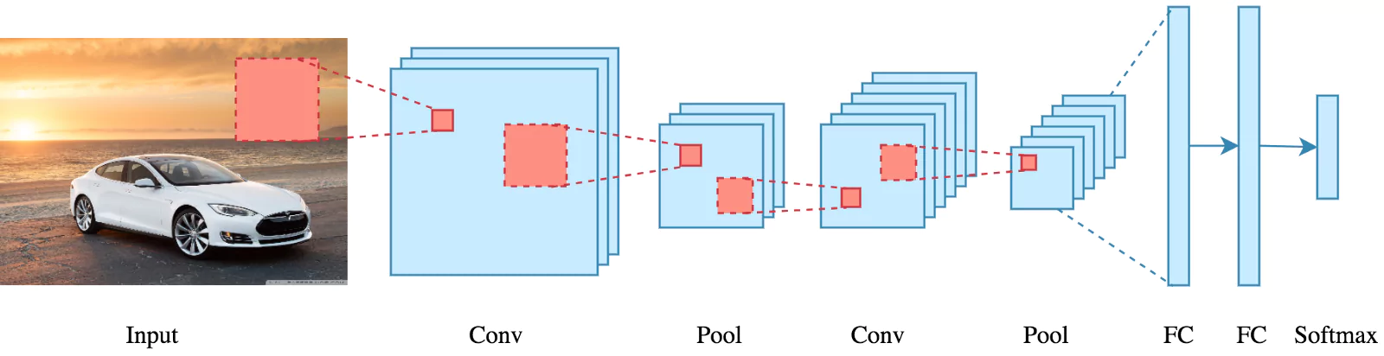
The cnn architecture uses a special technique called Convolution instead of relying solely on matrix multiplications like traditional neural networks. Convolutional networks use a process called convolution, which combines two functions to show how one changes the shape of the other.
Key Components of a CNN
The convolutional neural network is made of four main parts.
But how do CNNs Learn with those parts?
They help the CNNs mimic how the human brain operates to recognize patterns and features in images:
Convolutional layers
Rectified Linear Unit (ReLU for short)
Pooling layers
Fully connected layers
CNN Architecture — Pooling, Padding, and Strides

Slide 11
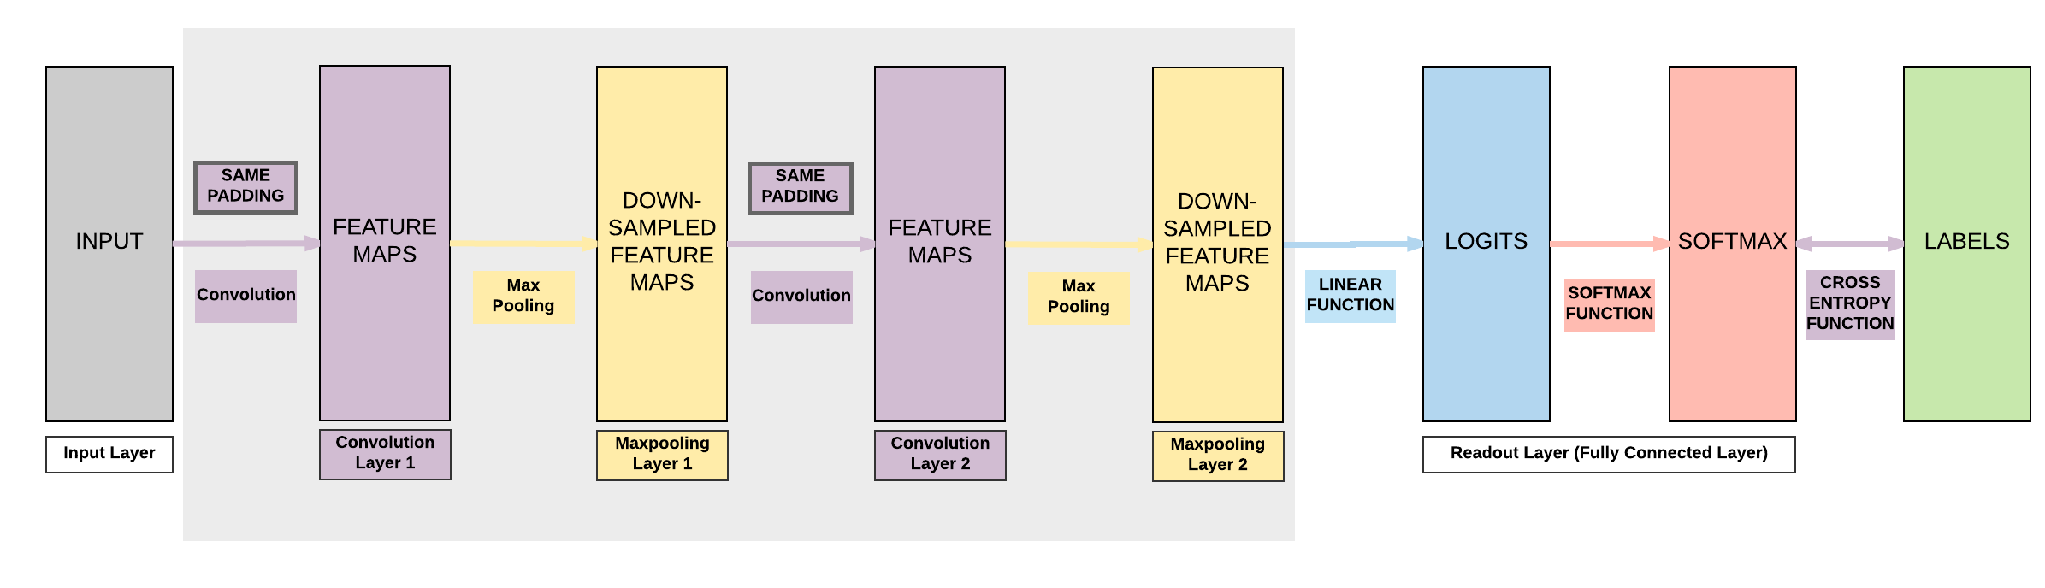

Slide 12
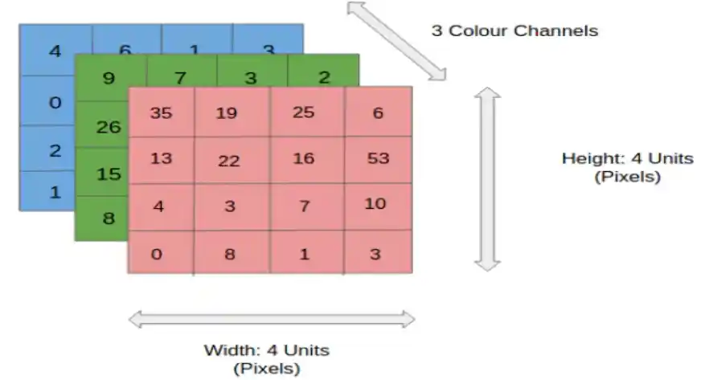
How Does CNN Work?
Before we go to the working of Convolutional neural networks (CNN), let’s cover the basics, such as what an image is and how it is represented.

Slide 13
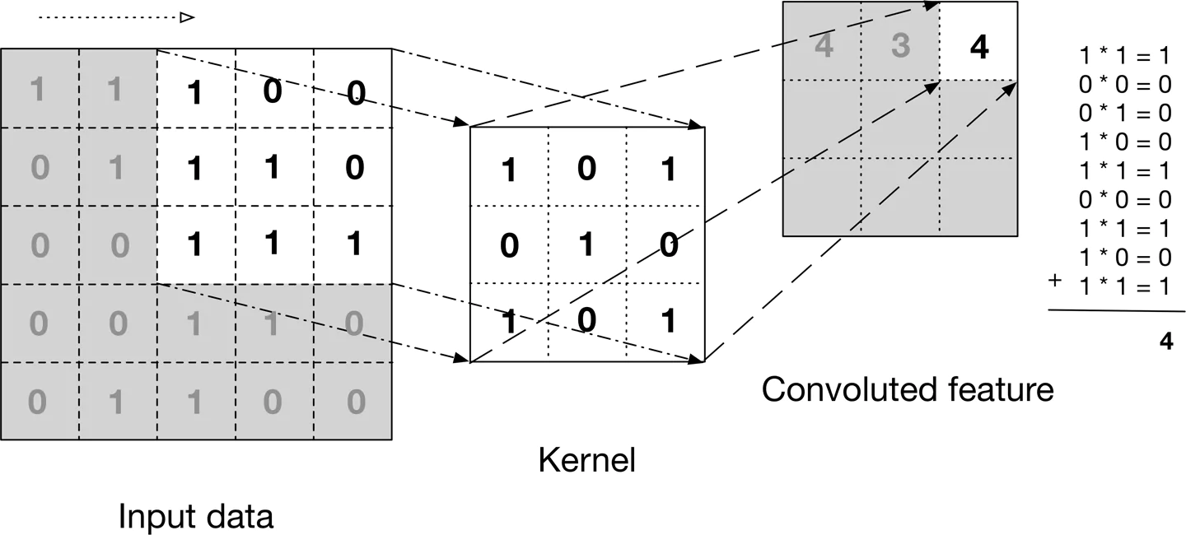
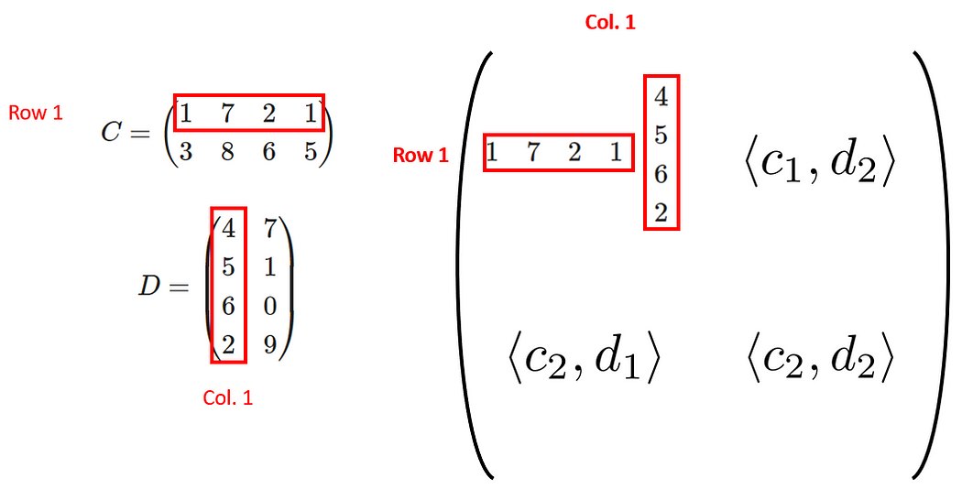
For simplicity, let’s stick with grayscale images as we try to understand how CNNs work.

Slide 14
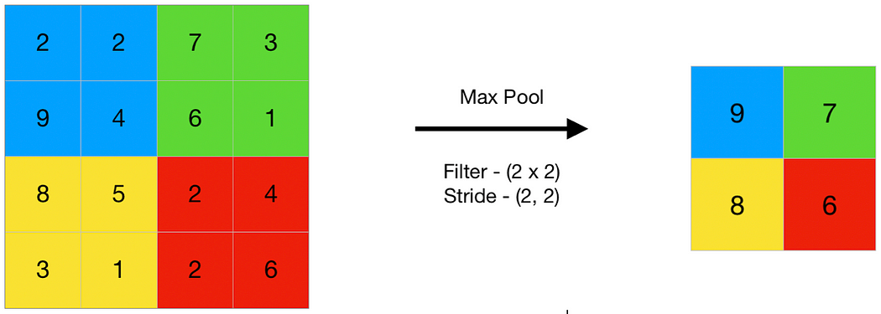
1. Pooling: Reducing complexity
Pooling is a down-sampling technique that reduces the size of feature maps while retaining the most important information. It helps in making the network computationally efficient and robust to small variations in the input image.
How Pooling works?
During pooling:
A sliding window moves over the feature map.
For each window, a single value (max or average) is computed.
The result is a reduced feature map.
Why use Pooling?
Reduces dimensionality: Smaller feature maps mean fewer computations in subsequent layers.
Improves generalization: By focusing on key features, pooling makes the network robust to noise and distortions in the image.
Types of Pooling
a. Max Pooling
b. Average Pooling

Slide 15
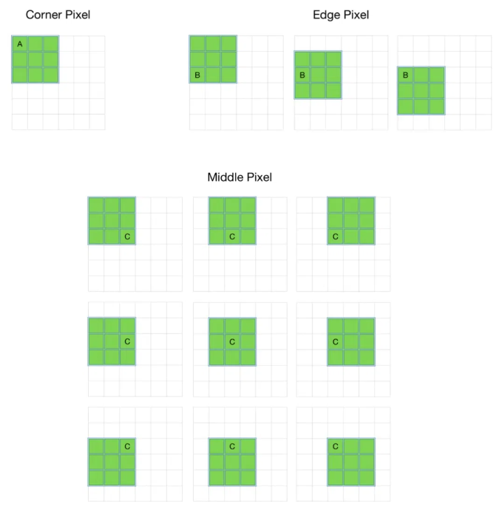
2. Padding: Preserving image borders
In CNNs, convolutional layers apply filters to images. If the filter overlaps only the central pixels, the edges and corners may not get the same attention. Padding solves this by adding extra pixels (usually zeros) around the image.
Types of Padding
a. Valid Padding
In valid padding, no extra pixels are added. The filter only slides over the original image, resulting in a smaller output feature map.
Example: A 5x5 image with a 3x3 filter produces a 3x3 output.
b. Same Padding
In same padding, pixels are added around the image so the output feature map has the same dimensions as the input. This is especially useful in deeper networks to maintain spatial resolution.

Slide 16
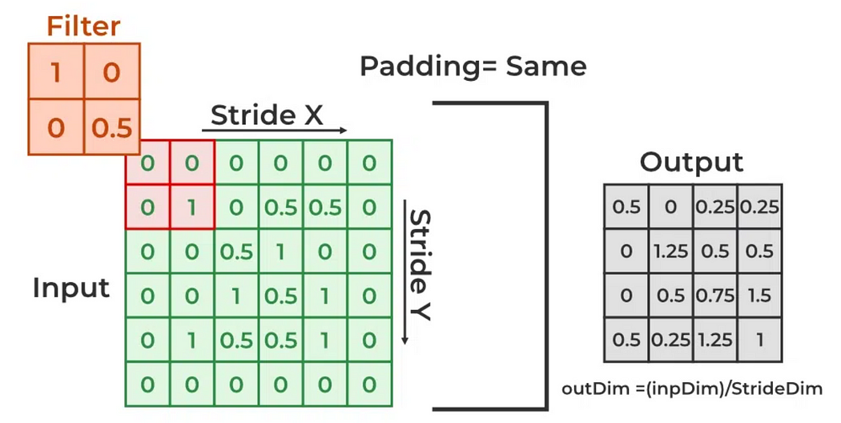
Example: A 5x5 image with a 3x3 filter and same padding produces a 5x5 output.

Slide 17
Why Padding is important?
Preserves spatial information: Edges and corners are often crucial in image processing, and padding ensures they are included in the output.
Allows deeper networks: Maintaining consistent dimensions across layers is essential for stacking multiple layers.

Slide 18
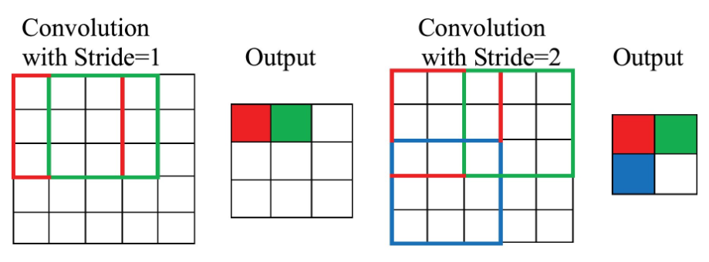
3. Strides: Controlling the Step Size
The stride determines how far the filter moves (or “strides”) across the image during convolution. It controls the overlap between the regions the filter scans.
When performing a convolution operation, the stride determines how many units the filter shifts at each step. This shift can be horizontal, vertical, or both, depending on the stride's configuration. For example, a stride of 1 moves the filter one pixel at a time, while a stride of 2 moves it two pixels.
https://medium.com/@bhatadithya54764118/day-51-cnn-architecture-pooling-padding-and-strides-852118529a0d

Slide 19
Key points about Strides
A stride of 1 means the filter moves one pixel at a time, resulting in high overlap and larger feature maps.
A stride greater than 1 skips pixels, producing smaller feature maps and reducing computational cost.
How Strides affect feature maps?
For a 6x6 image with a 3x3 filter:
Stride 1 results in a 4x4 feature map.
Stride 2 results in a 2x2 feature map.
When to adjust Strides?
Higher strides: When computational efficiency is prioritized.
Lower strides: When finer details in the image are crucial.
Padding ensures that important border details are not lost.
Strides determine how much the filter overlaps during convolution.
Pooling reduces the size of feature maps while keeping the most relevant information.
Wrapping up
Pooling, padding, and strides are the unsung heroes of CNN architecture. They work behind the scenes, optimizing the network’s performance and making it capable of processing complex image data efficiently. By mastering these concepts, you’re well on your way to designing powerful and efficient CNN models.

Slide 20
https://www.analyticsvidhya.com/blog/2021/05/convolutional-neural-networks-cnn/
https://www.analyticsvidhya.com/blog/2020/02/learn-image-classification-cnn-convolutional-neural-networks-3-datasets/
https://iq.opengenus.org/different-types-of-cnn-models/#google_vignette

Slide 21
Image Classification (binary ,multiclass)
https://www.kaggle.com/code/mdshahilansari/cats-or-dogs-using-cnn-with-transfer-learning/edit
Object Detection & Localizations
Image Segmentations
Siamese Network (comparision bw 2 img
GAN(Generative Adversal Networks) -->
https://www.geeksforgeeks.org/python-image-classification-using-keras/

